Slide 1
SNR study ERP
Mostly older subjects
n=29
ERP preprocessing
Resample to 250hz. Filter low=1hz, high=100hz. Load channel locations=Neuroscan65.elp. Rereference to average. Epoch data for clean ba’s. Run ICA=fastica. Remove bad components. Remove bad epochs.

Slide 3
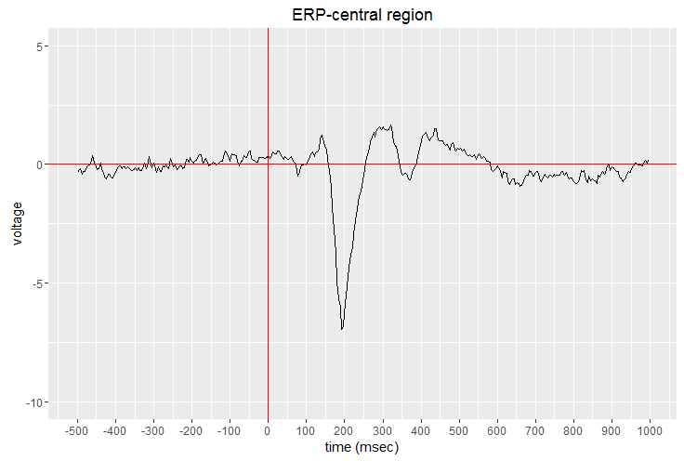
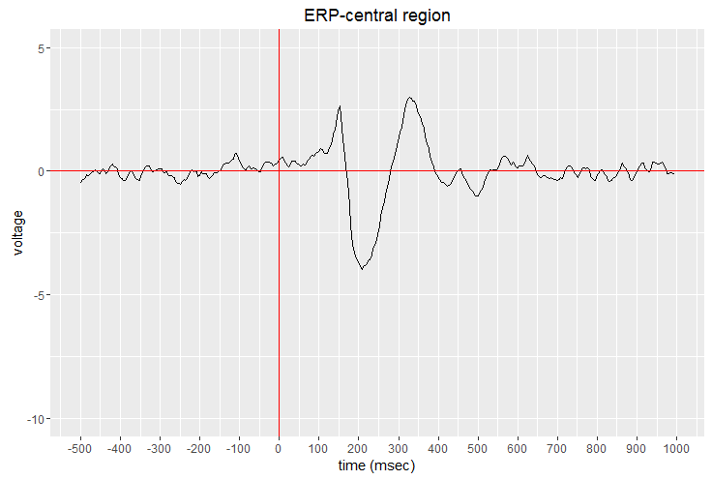
1018
1019

